Slide 1
UNIT 9- THE INTERNET
LH-2
ROLISHA STHAPIT

Slide 2
Contents
Introduction; How the Internet Works (Basic Architecture, Connecting to an ISP, The Internet Today); Internet Access Technologies (Digital Subscriber Line, Cable Modem, Fiber to the Home, WiMax); The Future of the Internet (Internet Governance, Building the Future).

Slide 3
Introduction
The Internet is the most used network in the world, but it is also one of the least understood. There is no one network that is the Internet. Instead, the Internet is a network of networks—a set of separate and distinct networks operated by various national and state government agencies, nonprofit organizations, and for-profit corporations.
The Internet exists only to the extent that these thousands of separate networks agree to use Internet protocols and to exchange data packets among one another. When you are on the Internet, your computer (iPad, smartphone, etc.) is connected to the network of an Internet service provider (ISP) that provides network services for you. Messages flow between your client device and the ISP’s network. Suppose you request a Web page on CNN.com, a website that is outside of your ISP’s network.
Your HTTP request flows from your device through your ISP’s network and through other networks that link your ISP’s network to the network of the ISP that provides Internet services for CNN. Each of these networks is separate and charges its own customers for Internet access but permits traffic from other networks to flow through them. In many ways, the Internet is like the universe. Each of us works in our own planet with its own rules (i.e., ISP) but each planet is interconnected with all the others.

Slide 4
Internet is a global communication system that links together thousands of individual networks. It allows exchange of information between two or more computers on a network. Thus, internet helps in transfer of messages through mail, chat, video & audio conference, etc. It has become mandatory for day-to-day activities: bills payment, online shopping and surfing, tutoring, working, communicating with peers, etc.
Internet was evolved in 1969, under the project called ARPANET (Advanced Research Projects Agency Network) to connect computers at different universities and U.S. defense. Soon after the people from different backgrounds such as engineers, scientists, students and researchers started using the network for exchanging information and messages.
In 1990s the internet working of ARPANET, NSFnet and other private networks resulted into Internet. Therefore, Internet is a global network of computer networks. It comprises of millions of computing devices that carry and transfer volumes of information from one device to the other. Desktop computers, mainframes, GPS units, cell phones, car alarms, video game consoles, are connected to the Net.

Slide 5
Components of the Internet:
Computers and Devices: The Internet is accessed through various devices, including computers, smartphones, tablets, and IoT (Internet of Things) devices. These devices connect to the Internet via wired or wireless technologies.
Network Infrastructure: The Internet comprises an intricate web of networks, including local area networks (LANs), wide area networks (WANs), and backbone networks. These networks use various technologies like Ethernet, fiber optics, and wireless connections to transmit data.
Protocols and Standards: The Internet operates on a set of protocols and standards, such as TCP/IP (Transmission Control Protocol/Internet Protocol). These protocols define how data is transmitted and received over the network, ensuring seamless communication between devices and networks.
Internet Service Providers (ISPs): ISPs are companies that provide Internet access to individuals, businesses, and organizations. They offer different types of connections, including broadband, DSL, cable, and fiber-optic, allowing users to connect to the Internet.

Slide 6
Web Servers and Websites: Web servers host websites and web applications, making them accessible to users worldwide. Websites are accessed using web browsers like Chrome, Firefox, Safari, or Edge.

Slide 7
How the Internet Works?
The internet is a global computer network that connects various devices and sends a lot of information and media. It uses an Internet Protocol (IP) and Transport Control Protocol (TCP)-based packet routing network. TCP and IP work together to ensure that data transmission across the internet is consistent and reliable, regardless of the device or location. Data is delivered across the internet in the form of messages and packets.
A message is a piece of data delivered over the internet, but before it is sent, it is broken down into smaller pieces known as packets. IP is a set of rules that control how data is transmitted from one computer to another via the internet. The IP system receives further instructions on how the data should be transferred using a numerical address (IP Address). The TCP is used with IP to ensure that data is transferred in a secure and reliable manner. This ensures that no packets are lost, that packets are reassembled in the correct order, and that there is no delay that degrades data quality.

Slide 8
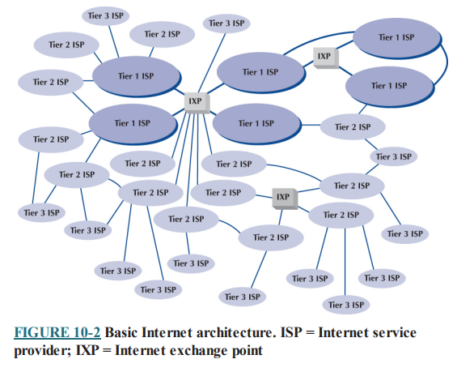
Basic Architecture:
The internet’s architecture is complex and distributed, allowing data to be transmitted globally between millions of interconnected devices.
The Internet is hierarchical in structure. At the top are the very large national Internet service providers (ISPs), such as AT&T and Sprint, that are responsible for large Internet networks. These national ISPs, called tier 1 ISPs, connect together and exchange data at Internet exchange points (IXPs).
Tier 1- National ISP, Tier – regional ISP, Tier 3- Local ISP

Slide 9
In the early 1990s, when the Internet was still primarily run by the U.S. National Science Foundation (NSF), the NSF established four main IXPs in the United States to connect the major tier 1 ISPs (the 1990s name for an IXP was network exchange point or NAP). When the NSF stopped funding the Internet, the companies running these IXPs began charging the ISPs for connections, so today the IXPs in the United States are all not-for-profit organizations or commercial enterprises run by various common carriers such as AT&T and Sprint. As the Internet has grown, so too has the number of IXPs; today there are several dozen IXPs in the United States with more than a hundred more spread around the world.
IXPs were originally designed to connect only large tier 1 ISPs. These ISPs in turn provide services for their customers and also to regional ISPs (sometimes called tier 2 ISPs) such as Comcast or BellSouth. These tier 2 ISPs rely on tier 1 ISPs to transmit their messages to ISPs in other countries. Tier 2 ISPs, in turn, provide services to their customers and to local ISPs (sometimes called tier 3 ISPs) who sell Internet access to individuals. As the number of ISPs grew, smaller IXPs emerged in most major cities to link the networks of these regional ISPs.
Because most IXPs and ISPs are now run by commercial firms, many of the early restrictions on who could connect to whom have been lifted. Most now openly solicit business from all tiers of ISPs and even large organizations. Regional and local ISPs often will have several connections into other ISPs to provide backup connections in case one Internet connection fails. In this way, they are not dependent on just one higher-level ISP

Slide 10
In general, ISPs at the same level do not charge one another for transferring messages they exchange. That is, a national tier 1 ISP does not charge another national tier 1 ISP to transmit its messages. This is called peering. Figure shows several examples of peering. It is peering that makes the Internet work and that has led to the belief that the Internet is free. This is true to some extent, but higher-level ISPs normally charge lower-level ISPs to transmit their data (e.g., a tier 1 will charge a tier 2 and a tier 2 will charge a tier 3). And, of course, any ISP will charge individuals like us for access!
In October 2005, an argument between two national ISPs shut down 45 million websites for a week. The two ISPs had a peering agreement, but one complained that the other was sending it more traffic than it should, so it demanded payment and stopped accepting traffic, leaving large portions of the network isolated from the rest of the Internet. The dispute was resolved, and they began accepting traffic from each other and the rest of the Internet again. In Figure, each of the ISPs is an autonomous system. Each ISP is responsible for running its own interior routing protocols and for exchanging routing information via the Border Gateway Protocol (BGP) exterior routing protocol at IXPs and at any other connection points between individual ISPs.

Slide 11
Connecting to an ISP:
Each of the ISPs is responsible for running its own network that forms part of the Internet. ISPs make money by charging customers to connect to their part of the Internet. Local ISPs charge individuals for broadband or dial-up access whereas national and regional ISPs (and sometimes local ISPs) charge larger organizations for higher-speed access.
Each ISP has one or more points of presence (POP). A POP is simply the place at which the ISP provides services to its customers. To connect into the Internet, a customer must establish a circuit from his or her location into the ISP POP. For individuals, this is often done using a DSL modem, cable modem, or dial-up modem over a traditional telephone line. This call connects to the modem pool at the ISP and from there to a remote-access server (RAS), which checks the user ID and password to make sure the caller is a valid customer. Once logged in, the user can begin sending TCP/IP packets from his or her computer over the phone to the POP. Figure shows a POP using a switched backbone with a layer-2 switch. The POP backbone can take many forms.

Slide 12
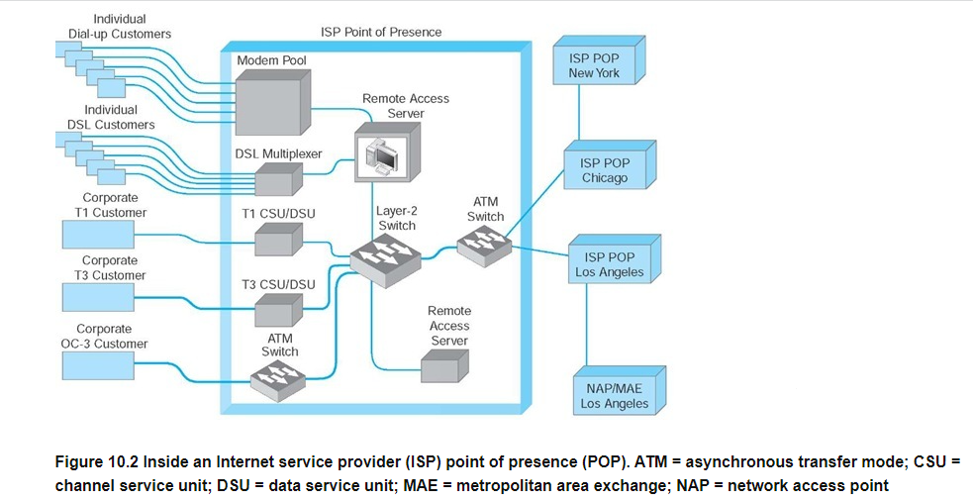

Slide 13
There are Internet access technologies such as DSL, cable modem, and Wireless Application Protocol (WAP). Customers who need more network capacity simply lease a higher-capacity circuit. Figure shows corporate customers with T1, T3, and OC-3 connections into the ISP POP. It is important to note that the customer must pay for both Internet access (paid to the ISP) and for the circuit connecting from their location to the POP (usually paid to the local exchange carrier [e.g., BellSouth, AT&T], but sometimes the ISP also can provide circuits). For a T1 connection, for example, a company might pay the local exchange carrier $400 per month to provide the T1 circuit from its offices to the ISP POP and also pay the ISP $300 per month to provide the Internet access.
As Figure shows, the ISP POP is connected in turn to the other POPs in the ISP’s network. Any messages destined for other customers of the same ISP would flow within the ISP’s own network. In most cases, the majority of messages entering the POP are sent outside of the ISP’s network and thus must flow through the ISP’s network to the nearest NAP (Network Access Point)/MAE (Metropolitan Ares Exchange), and from there, into some other ISP’s network.

Slide 14
The Internet Today:
Sprint is one of the national ISPs in North America. Figure shows Sprint’s North American backbone as it existed. As you can see, Sprint has a number of Internet circuits across the United States and Canada. Many interconnect in Chicago where Sprint connects into the Chicago NAP. Sprint also connects into major NAPs and MAEs in Reston, Virginia; Miami; Los Angeles; San Jose; Palo Alto; Vancouver; Calgary; Toronto; and Montreal. Most of the circuits are SONET OC-12, but a few are OC-48 and OC-192.
Today, the backbone circuits of the major U.S. national ISPs operate at SONET OC-48 and OC-192. Most of the largest national ISPs (e.g., Sprint, Cable & Wireless) plan to convert their principal backbones to OC-192 (10 Gbps). A few are now experimenting with OC-768 (80 Gbps), and several are in the planning stages with OC-3072 (160 Gbps). This is good because the amount of Internet traffic has been growing rapidly. The Internet traffic in the U.S. is expected to reach 80 Tbps (80 trillion bits per second) by 2011.

Slide 15
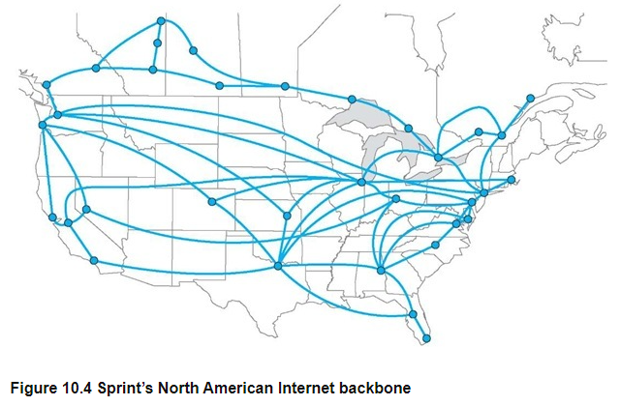
As traffic increases, ISPs can add more and faster circuits relatively easily, but where these circuits come together at NAPs and MAEs, bottlenecks are becoming more common. Network vendors such as Cisco and Juniper are making larger and larger switches capable of handling these high-capacity circuits, but it is a daunting task. When circuit capacities increase by 100 percent, switch manufacturers also must increase their capacities by 100 percent. It is simpler to go from a 622 Mbps circuit to a 10 Gbps circuit than to go from a 20 Gbps switch to a 200 Gbps switch.

Slide 16
Internet Access Technologies
Internet access technologies have evolved significantly over the years, providing various options for connecting to the Internet based on different requirements, speeds, and geographic locations. There are many ways in which individuals and organizations can connect to an ISP. Some individuals use 56-Kbps dial-up modems over telephone lines; some use DSL or cable modem.
Many organizations lease T1 or T3 lines into their ISPs. DSL and cable modem technologies are commonly called broadband technologies because they provide higher-speed communications than traditional modems. It is important to understand that Internet access technologies are used only to connect from one location to an ISP. Unlike the MAN and WAN technologies, Internet access technologies cannot be used for general-purpose networking from any point to any point. In this section, we discuss four principal Internet access technologies (DSL, cable modem, fixed wireless, and mobile wireless).

Slide 17
Digital Subscriber Line (DSL):
Digital subscriber line (DSL) is a family of point-to-point technologies designed to provide high-speed data transmission over traditional telephone lines. The reason for the limited capacity on traditional telephone circuits lies with the telephone and the switching equipment at the end offices.
The actual cable in the local loop from a home or office to the telephone company end office is capable of providing much higher data transmission rates. So DSL usually requires just changing the telephone equipment, not rewiring the local loop, which is what has made it so attractive.
DSL, or Digital Subscriber Line, is like a magic pathway that brings the internet to your home using your regular phone line. It's like having a secret part of the phone line dedicated just for internet stuff. When you use DSL, a special box called a modem at your home turns your computer's signals into magic signals that travel super-fast through this secret internet path. This means you can be online all the time without needing to dial in.
DSL, or Digital Subscriber Line, is a technology that transforms traditional telephone lines into high-speed internet connections. By dividing the existing copper lines into separate channels for voice and data, DSL allows users to have a constant and faster internet connection without tying up the phone line.

Slide 18
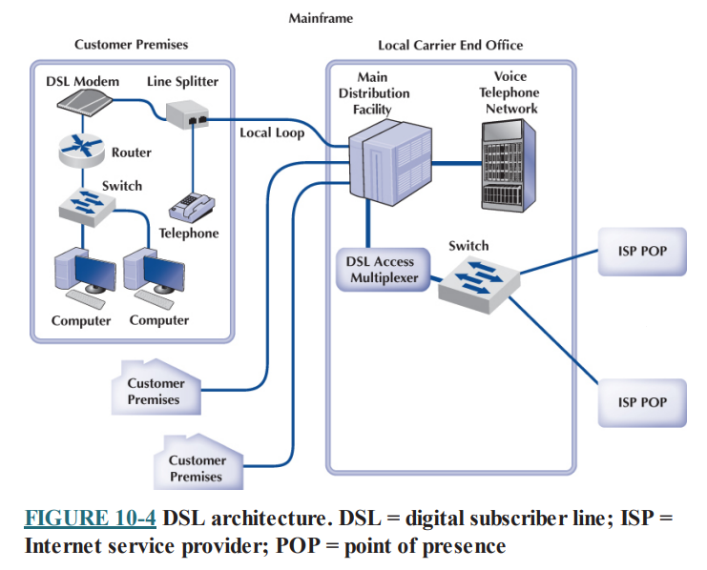
Utilizing a DSL modem, digital data is converted into signals that can be transmitted over the telephone line, offering an "always-on" broadband connection for homes and businesses. While distance from the telephone exchange can affect the signal strength and speed, DSL has been a widely adopted technology for providing internet access using the existing telephone infrastructure.

Slide 19
DSL uses the existing local loop cable but places different equipment on the customer premises (i.e., the home or office) and in the telephone company end office. The equipment that is installed at the customer location is called the customer premises equipment (CPE). Figure shows one common type of DSL installation. The CPE in this case includes a line splitter that is used to separate the traditional voice telephone transmission from the data transmissions. The line splitter directs the telephone signals into the normal telephone system so that if the DSL equipment fails, voice communications are unaffected.
The line splitter also directs the data transmissions into a DSL modem, which is sometimes called a DSL router. This is both a modem and a frequency division multiplexing (FDM) multiplexer. The DSL modem produces Ethernet packets so it can be connected directly into a computer or to a router and can serve the needs of a small network. Most DSL companies targeting home users combine all of these devices (and a wireless access point) into one device so that consumers just have to install one box, rather than separate line splitters, modems, routers, switches, and access points.

Slide 20
Figure also shows the architecture within the local carrier’s end office (i.e., the telephone company office closest to the customer premises). The local loops from many customers enter and are connected to the main distribution facility (MDF). The MDF works similarly to the CPE line splitter; it splits the voice traffic from the data traffic and directs the voice traffic to the voice telephone network and the data traffic to the DSL access multiplexer (DSLAM). The DSLAM demultiplexes the data streams and converts them into digital data, which are then distributed to the ISPs. Some ISPs are collocated, in that they have their POPs physically in the telephone company end offices. Other ISPs have their POPs located elsewhere.
Asymmetric DSL (ADSL) uses FDM to create three separate channels over the one local loop circuit. One channel is the traditional voice telephone circuit. A second channel is a relatively highspeed data channel downstream from the carrier’s end office to the customer. The third channel is a slightly slower data channel upstream from the customer to the carrier’s end office. ADSL is called asymmetric because its two data channels have different speeds. Each of the two data channels is further multiplexed using time division multiplexing so they can be subdivided.

Slide 21
Advantages of DSL:
Availability: DSL is widely available in urban, suburban, and even some rural areas. It utilizes existing telephone lines, making it accessible to a large portion of the population.
Affordability: DSL services are often more affordable than some high-speed alternatives such as fiber optic connections. This makes DSL a cost-effective option for many users.
Stability and Reliability: DSL connections are stable and reliable. Unlike cable internet, DSL does not share bandwidth with neighbors, so users experience consistent speeds even during peak usage times.
Low Latency: DSL typically has low latency, making it suitable for online gaming, video conferencing, and other real-time applications.
Security: DSL connections are private and secure. Data transmitted over DSL lines is difficult for outsiders to intercept, enhancing user privacy. No Interference from Weather: Unlike satellite internet, DSL connections are not affected by weather conditions, ensuring a stable internet experience regardless of outdoor conditions

Slide 22
Disadvantages of DSL:
Distance Limitations: DSL speed decreases significantly with distance from the telephone exchange. Users closer to the exchange experience higher speeds than those farther away.
Speed Variability: The speed of DSL connections can vary based on the quality and condition of the copper lines. Older or poorly maintained lines may result in slower speeds.
Limited Upload Speeds: DSL connections usually have slower upload speeds compared to download speeds. This limitation can impact activities like uploading large files or engaging in video conferencing.
Competition with Newer Technologies: DSL competes with newer technologies like Up fiber optics and cable internet, which offer higher speeds and more reliable connections.
Dependence on Copper Lines: DSL relies on aging copper telephone lines. These lines might require maintenance and repair, and their quality can deteriorate over time. Limited Support for Multiple Devices: DSL might struggle to support multiple connected devices simultaneously, especially in households with heavy internet usage.

Slide 23
Cable Modem:
One alternative to DSL is the cable modem, a digital service offered by cable television companies. There are several competing standards, but the Data over Cable Service Interface Specification (DOCSIS) standard is the dominant one. DOCSIS is not a formal standard but is the one used by most vendors of hybrid fiber coax (HFC) networks (i.e., cable networks that use both fiber-optic and coaxial cable). As with DSL, these technologies are changing rapidly.
Architecture Cable modem architecture is very similar to DSL—with one very important difference. DSL is a point-to-point technology whereas cable modems use shared multipoint circuits. With cable modems, each user must compete with other users for the available capacity.
Furthermore, because the cable circuit is a multipoint circuit, all messages on the circuit go to all computers on the circuit. If your neighbors were hackers, they could use pocket sniffers such as Ethereal to read all messages that travel over the cable, including yours.

Slide 24
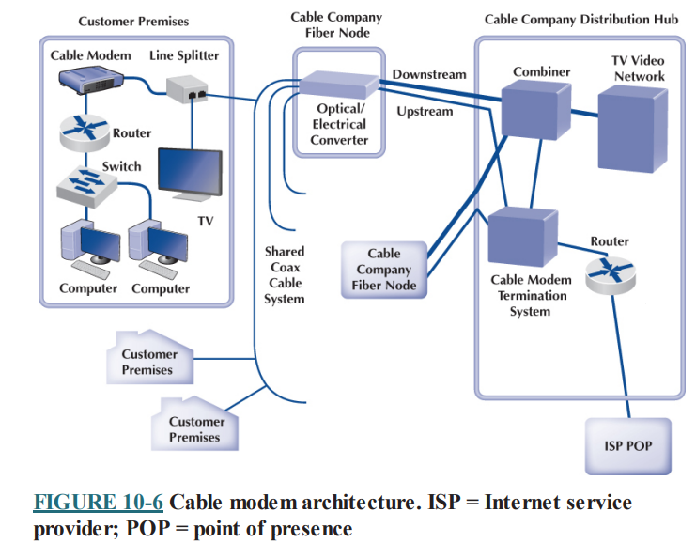
Figure shows the most common architecture for cable modems. The cable TV circuit enters the customer premises through a cable splitter that separates the data transmissions from the TV transmissions and sends the TV signals to the TV network and the data signals to the cable modem. The cable modem (both a modem and frequency division multiplexer) translates from the cable data into Ethernet packets, which then are directed into a computer to a router and hub for distribution in a small network.

Slide 25
The cable TV cable entering the customer premises is a standard coaxial cable. A typical segment of cable is shared by anywhere from 300 to 1,000 customers, depending on the cable company that installed the cable. These 300 to 1,000 customers share the available data capacity, but of course, not all customers who have cable TV will choose to install cable modems. This coax cable runs to a fiber node, which has an optical-electrical (OE) converter to convert between the coaxial cable on the customer side and fiber-optic cable on the cable TV company side. Each fiber node serves as many as half a dozen separate coaxial cable runs.
The fiber nodes are in turn connected to the cable company distribution hub (sometimes called a headend) through two separate circuits: an upstream circuit and a downstream circuit. The upstream circuit, containing data traffic from the customer, is connected into a cable modem termination system (CMTS). The CMTS contains a series of cable modems/multiplexers and converts the data from cable modem protocols into protocols needed for Internet traffic, before passing them to a router connected to an ISP POP. Often, the cable company is an Internet regional ISP, but sometimes it just provides Internet access to a third-party ISP.

Slide 26
The downstream circuit to the customer contains both ordinary video transmissions from the cable TV video network and data transmissions from the Internet. Downstream data traffic enters the distribution hub from the ISP POP and is routed through the CMTS, which produces the cable modem signals. This traffic is then sent to a combiner, which combines the Internet data traffic with the ordinary TV video traffic and sends it back to the fiber node for distribution.
Types of Cable Modems The DOCSIS standard provides many types of cable modems. The maximum speed is about 150 Mbps downstream and about 100 Mbps upstream, although most cable TV companies provide at most 27 Mbps downstream and 10 Mbps upstream. Cable modems can be configured to limit capacity, so the most common speeds offered by most cable providers range from 1-10 Mbps downstream and 256 Kbps to 1Mbps upstream. Of course, this capacity is shared, so an individual user will only see this when no other computers on his or her segment are active.

Slide 27
Advantages of Cable Modem:
High Speeds: Cable Internet provides high-speed internet access, especially in areas where fiber optic connections are not available. It offers faster speeds compared to traditional DSL connections.
Widespread Availability: Cable Internet is widely available, particularly in urban and suburban areas. This availability makes it accessible to a large portion of the population.
Bundled Services: Cable providers often offer bundled packages that include Internet, cable TV, and sometimes phone services. This bundling can lead to cost savings for consumers who use multiple services from the same provider.
Reliable Connection: Cable Internet connections are generally stable and reliable, providing a consistent experience for users.
Shared Infrastructure: Cable Internet uses the same infrastructure as cable television. If you already have cable TV service, setting up cable Internet is often convenient.

Slide 28
Disadvantages of Cable Modem:
Shared Bandwidth: One of the significant drawbacks of cable Internet is shared bandwidth. Since multiple users in the same neighborhood share the same cable line, connection speeds can slow down during peak usage times when many people are online. This is especially true if the local infrastructure is not well-maintained.
Limited Upload Speeds: Cable Internet often provides slower upload speeds compared to download speeds. This limitation can affect activities like online gaming and video conferencing, which require stable upload connections.
Vulnerable to Interference: Cable Internet signals can be affected by electromagnetic interference. Problems such as signal degradation due to damaged cables or interference from other electronic devices can impact the quality of the connection.
Reliability during Outages: During power outages, cable Internet service might also be affected unless there is a backup power source for the network infrastructure. This can disrupt internet access when users need it most.

Slide 29
Pricing and Bundling: While bundling can save money, some users might find that cable Internet bundled with other services can lead to complex pricing structures. making it challenging to discern the actual cost of the Internet service alone.
Limited Availability in Rural Areas: While widely available in urban and suburban regions, cable Internet is not as accessible in rural areas. Remote locations might lack the necessary infrastructure for cable Internet connections.
Higher Data Allowances: Cable Internet plans often come with higher data allowances compared to mobile broadband services, allowing users to download and stream more content without exceeding their data limits.
Decent Upload Speeds: While not as fast as download speeds, cable Internet usually provides acceptable upload speeds for activities like uploading files and video conferencing.

Slide 30
Fiber To the Home (FTTH):
Fiber Internet is also another internet access type that is provided by service providers. In DSL existing analog cable network is used and in cable internet, cable network is used. But with fiber internet, service providers provide an additional enhanced cabling underground with fiber.
Fiber to the home (FTTH) is exactly what it sounds like: running fiberoptic cable into the home. The traditional set of hundreds of copper telephone lines that run from the telephone company switch office is replaced by one fiber-optic cable that is run past each house or office in the neighborhood. Data are transmitted down the signal fiber cable using wavelength division multiplexing (WDM), providing hundreds or thousands of separate channels. FTTH is only available to about a quarter of the homes in the United States and Canada, but it is growing.
FTTH architecture is very similar to DSL and cable modem. At each subscriber location, an optical network unit (ONU) (also called an optical network terminal [ONT]) acts like a DSL modem or cable modem and converts the signals in the optical network into an Ethernet format. The ONU acts as an Ethernet switch and can also include a router. FTTH is a dedicated point-to-point service like DSL, not a shared multipoint service like cable modem.

Slide 31
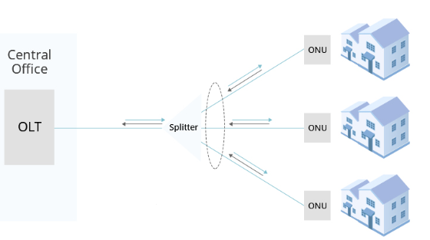
Providers of fiber to the home can use either active optical networking or passive optical networking to connect the ONU in the customer’s home. Active networking means that the optical devices require electrical power and works in much the same way as traditional electronic switches and routers. Passive optical networking devices require no electrical current and thus are quicker and easier to install and maintain than traditional electrical based devices, but because they are passive, the optical signal fades quickly, giving a maximum range of about 10 miles.

Slide 32
There are many types of FTTH, and because FTTH is a new technology, these types are likely to evolve as FTTH enters the market and becomes more widely adopted. Common types provide 10–100 Mbps downstream and 1–10 Mbps upstream. The most commonly used type provides 15 Mbps downstream and 4 Mbps upstream. Newer versions have been announced targeted at business users that provide 1 Gbps down and 100 Mbps up

Slide 33
Advantages of FTTH:
Incredibly High Speeds: FTTH offers some of the fastest internet speeds available, with symmetrical upload and download speeds that can range from hundreds of Mbps to 1 Gbps or even more.
Low Latency: Fiber optic connections have very low latency, making them ideal for real-time applications, online gaming, and video conferencing.
Reliable Performance: Fiber optics are less susceptible to interference, signal degradation, and electromagnetic noise, ensuring a stable and reliable internet connection.
Higher Bandwidth: FTTH provides significantly higher bandwidth compared to other internet technologies, allowing for the concurrent use of multiple devices without compromising speed or quality.
Security: Fiber optic signals do not radiate electromagnetic signals, making it difficult for hackers to intercept data. Additionally, fiber networks are secure from interference and eavesdropping.
Scalability: FTTH networks are highly scalable and can support future technologies and higher speeds without the need for significant infrastructure upgrades.

Slide 34
Disadvantages of FTTH:
Initial Cost and Deployment Challenges: Deploying FTTH infrastructure involves high initial costs, including the installation of fiber optic cables and network equipment.
Limited Availability: FTTH is not as widely available as other internet technologies such as cable or DSL, especially in rural and remote regions.
Dependency on External Factors: FTTH infrastructure may be affected by external factors such as construction work, natural disasters, or physical damage to cables.
Fiber Installation in Existing Buildings: Retrofitting existing buildings with fiber optic cables can be challenging and costly, especially in densely populated urban areas.
Dependency on Power Supply: FTTH network equipment, including Optical Network Terminals (ONTs), requires a power source. During power outages, users might lose internet connectivity.
Fiber Fragility: Fiber optic cables are delicate and can be damaged easily, requiring careful handling and protection during installation and maintenance.

Slide 35
WiMax:
WiMax (short for Worldwide Interoperability for Microwave Access) is the commercial name for a set of standards developed by the IEEE 802.16 standards group. WiMax is a family of technologies that is much like the 802.11 Wi-Fi family. It reuses many of the Wi-Fi components and was designed to connect easily into Ethernet LANs. WiMax can be used as a fixed wireless technology to connect a house or an office into the Internet, but its future lies in its ability to connect mobile laptops and smartphones into the Internet.
WiMax is a relatively old technology. The problem is that computer manufacturers have been waiting for ISPs to build WiMax networks before they build WiMax into their computers. Meanwhile, ISPs have been waiting for computer manufacturers to provide WiMax-capable computers before they build WiMax networks. And so we have a catch-22.
Many experts envision a future where both Wi-Fi and WiMax coexist. Laptops and smartphones will connect to Wi-Fi networks in home and office locations where Wi-Fi is available. If Wi-Fi is not available and the user has subscribed to WiMax services, then the laptop or smartphone will connect to the WiMax network. Of course, they have made this prediction every year since 2011, and WiMax is still not common.

Slide 36
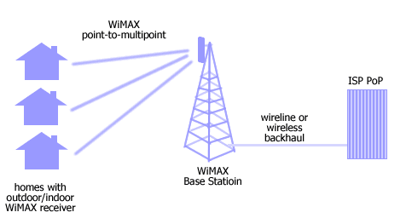
Architecture
Although WiMax can be used in fixed locations to provide Internet access to homes and offices, we will focus on mobile use as this is likely to be the most common use. Mobile WiMax works in much the same way as Wi-Fi. The laptop or smartphone has a WiMax network interface card (NIC) and uses it to establish a connection to a WiMax access point (AP). Many devices use the same AP, so WiMax is a shared multipoint service in which all computers must take turns transmitting. Media access control is controlled access, using a version of the 802.11 point coordination function (PCF).

Slide 37
WiMax Base Station:
Radio Access Network (RAN): The base station is part of the Radio Access Network, responsible for managing the wireless communication with subscriber stations.
Connection to Core Network: The base station connects to the core network, which can include elements like routers, switches, and gateways. This connection allows user data to flow between the wireless network and the broader internet or private networks.
WiMax Subscriber Station
Wireless Link: The subscriber station communicates with the base station using a wireless link, enabling users to access the network without physical connections.
User Devices: Subscriber stations can be integrated into various user devices, such as WiMax modems, routers, or embedded modules in smartphones and laptops.
There are several types of WiMax available, with new versions under development. The most common type of mobile wireless provides speeds of 40 Mbps, shared among all users of the same AP. Some providers have versions that run at 70 Mbps. New versions under development promise speeds of 300 Mbps.

Slide 38
Advantages of WiMax:
Wide Coverage Area: WiMAX can cover an area of up to 50 kilometers, making it suitable for providing broadband access in rural and underserved areas.
High Data Rates: WiMAX can provide data rates of up to 75 Mbps, which is higher than many other wireless technologies.
Scalability: WiMAX can be easily scaled to support a large number of users and devices.
Interoperability: WiMAX is based on an international standard, which allows for interoperability between different vendors' equipment.
Cost-effective: WiMAX is a cost-effective solution for providing broadband access in areas where it is not economically feasible to deploy wired infrastructure.

Slide 39
Disadvantages of WiMAX
Limited Mobility: WiMAX is designed for fixed or nomadic (semi-fixed) use, not for mobile use.
Interference: WiMAX operates in the same frequency range as other wireless technologies, which can lead to interference.
Security Concerns: WiMAX uses a shared spectrum, which can make it vulnerable to security threats such as eavesdropping and jamming.
Limited device availability: WiMAX devices are not as widely available as devices for other wireless technologies, such as WiFi.
Limited penetration: WiMAX signals may have trouble penetrating through walls, buildings and other obstacles.

Slide 40
The Future of the Internet
The future of the Internet is a fascinating and rapidly evolving landscape, shaped by emerging technologies, changing user behaviors, and global connectivity. Here are several key trends and developments that may define the future of the Internet:
5G and Beyond
Artificial Intelligence (AI) and Machine Learning (ML)
Internet of Things (IoT)
Blockchain and Decentralization
Augmented Reality (AR) and Virtual Reality (VR)
Sustainable Internet
Digital Inclusivity and Accessibility etc.

Slide 41
Internet Governance
Internet governance refers to the processes, rules, and organizations that shape how the Internet is managed, controlled, and developed. Given the global and decentralized nature of the Internet, effective governance is essential to ensure its stability, security, and accessibility.
Because the Internet is a network of networks, no one organization operates the Internet. The closest thing the Internet has to an owner is the Internet Society (internetsociety.org). The Internet Society is an open-membership professional society with about 150 organizational members and 65,000 individual members in more than 100 countries, including corporations, government agencies, and foundations that have created the Internet and its technologies.
Because membership is open, anyone, including students, is welcome to join and vote on key issues facing the Internet. Its mission is to ensure “the open development, evolution and use of the Internet for the benefit of all people throughout the world.”

Slide 42
It works in three general areas: public policy, education, and standards. In terms of public policy, the Internet Society participates in the national and international debates on important issues such as censorship, copyright, privacy, and universal access. It delivers training and education programs targeted at improving the Internet infrastructure in developing nations. Its most important activity lies in the development and maintenance of Internet standards. It works through four interrelated standards bodies: the Internet Engineering Task Force, Internet Engineering Steering Group, Internet Architecture Board, and Internet Research Task Force.
The Internet Engineering Task Force (IETF) (www.ietf.org) is a large, open international community of network designers, operators, vendors, and researchers concerned with the evolution of the Internet architecture and the smooth operation of the Internet. The IETF works through a series of working groups, which are organized by topic (e.g., routing, transport, and security). The request for comments (RFCs) that form the basis for Internet standards are developed by the IETF and its working groups. Closely related to the IETF is the Internet Engineering Steering Group (IESG).

Slide 43
The IESG is responsible for technical management of IETF activities and the Internet standards process. It administers the process according to the rules and procedures that have been ratified by the Internet Society trustees. The IESG is directly responsible for the actions associated with entry into and movement along the Internet “standards track,” including final approval of specifications as Internet standards. Each IETF working group is chaired by a member of the IESG.
The Internet Research Task Force (IRTF) operates much like the IETF: through small research groups focused on specific issues. Whereas IETF working groups focus on current issues, IRTF research groups work on long term issues related to Internet protocols, applications, architecture, and technology.

Slide 44
Building the Future:
The Internet is changing. New applications and access technologies are being developed at lightning pace. But these innovations do not change the fundamental structure of the Internet. It has evolved more slowly because the core technologies (TCP/IP) are harder to change gradually; it is difficult to change one part of the Internet without changing the attached parts. Many organizations in many different countries are working on dozens of different projects in an attempt to design new technologies for the next version of the Internet.
Besides providing very-high-speed Internet connections, these networks are intended to experiment with new protocols that 1 day may end up on the future Internet. For example, most circuits run IPv6 as the primary network layer protocol rather than IPv4. Most are also working on new ways to provide quality of service (QoS) and multicasting. Internet2 is also developing new applications for a high-speed Internet, such as tele-immersion and videoconferencing.

